Slide 1
Week 2
Goals
&
Goal Statement

Slide 3
What can Market America® Offer us?
Quality Products
Financial Freedom
Time Freedom

Slide 4
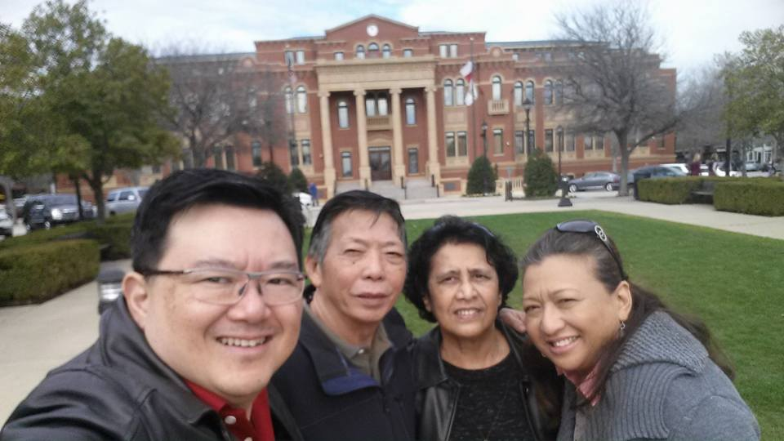
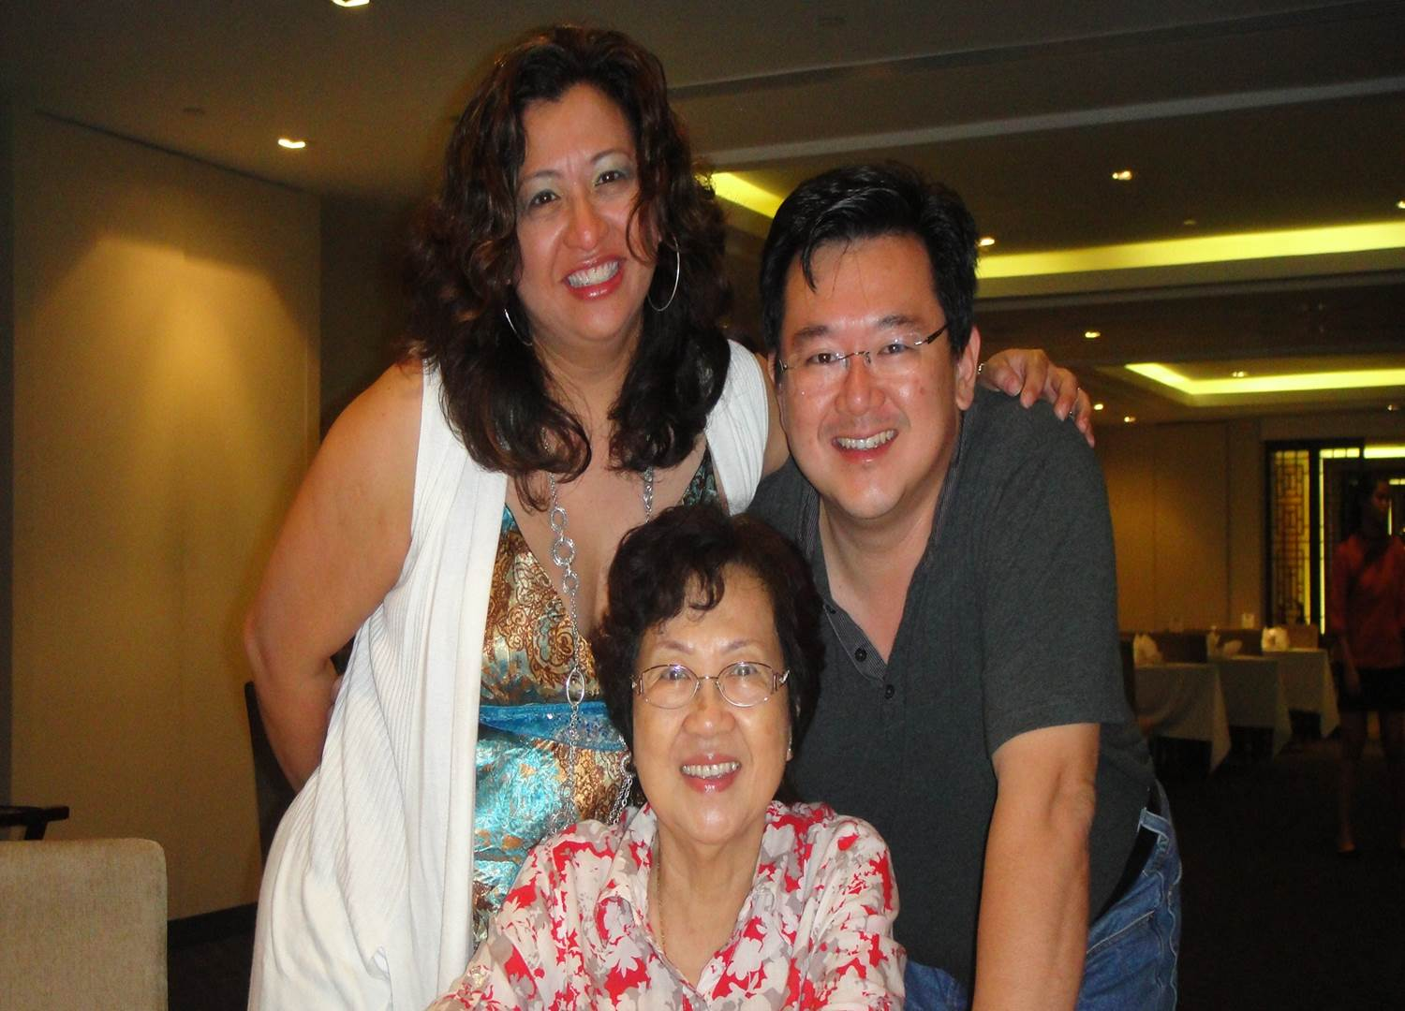
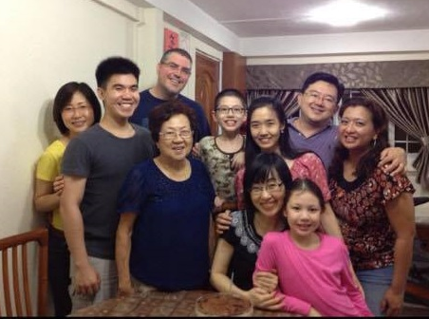
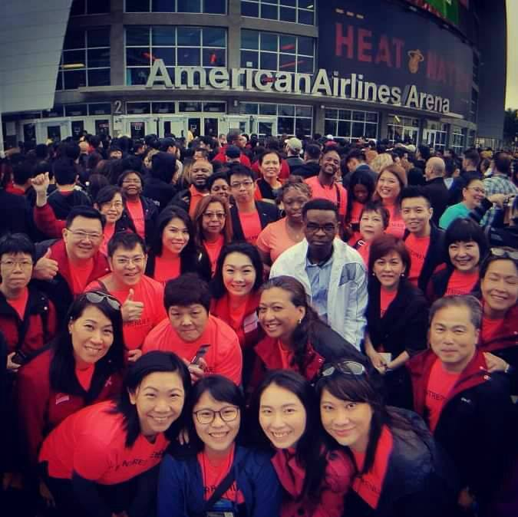
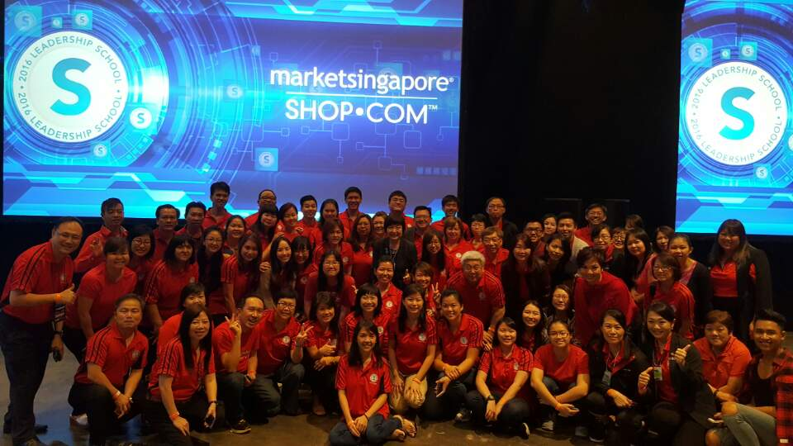
My Why
What is Your
Why

Slide 5
Decide When You Want it
Set target dates for achievement
Measure your progress against the date
Adjust the date or goal to be in line with reality

Slide 6
Example
Write your Goal Statement
“It is December 31, 20 __, I am a Supervising Coordinator , no credit card debt and I am living in 2000 square foot Condo. I am driving a Porsche, vacationing four months out of the year. My marriage is happier without financial pressure. My family and I spend more quality time together and pursue interests we all enjoy”.
50 to 100 Words – Read it twice a day
Add Your “Action Plan”

Slide 7
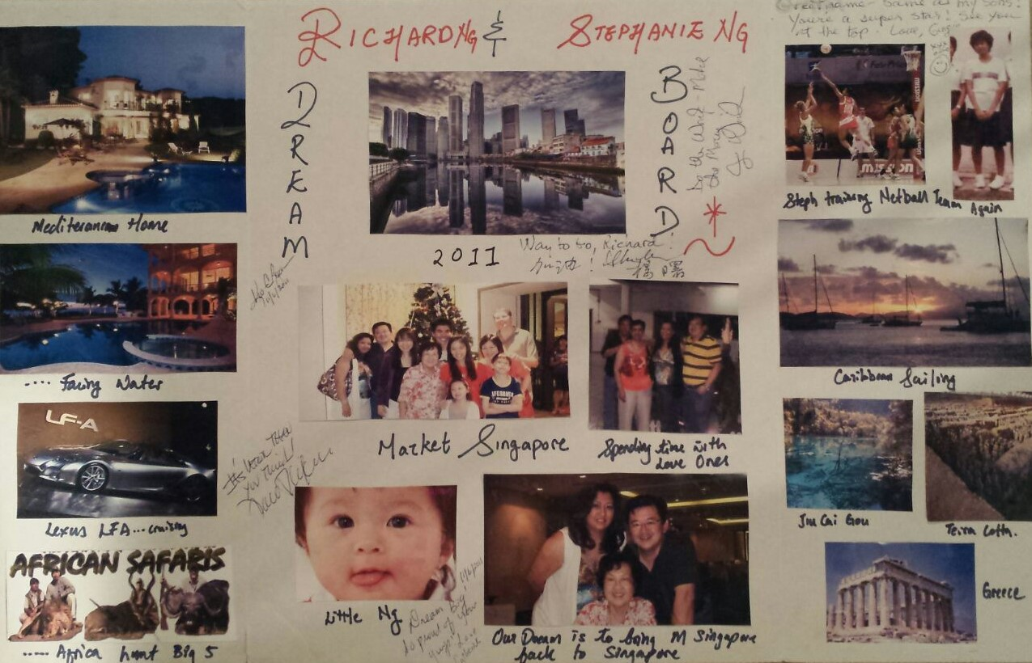
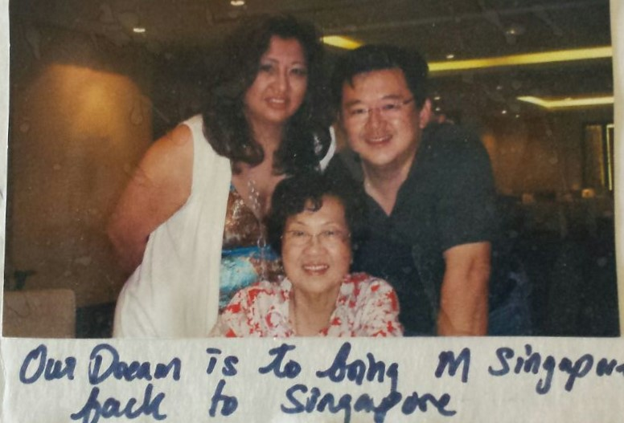
Dream Board
2014 Market Singapore Open

Slide 8
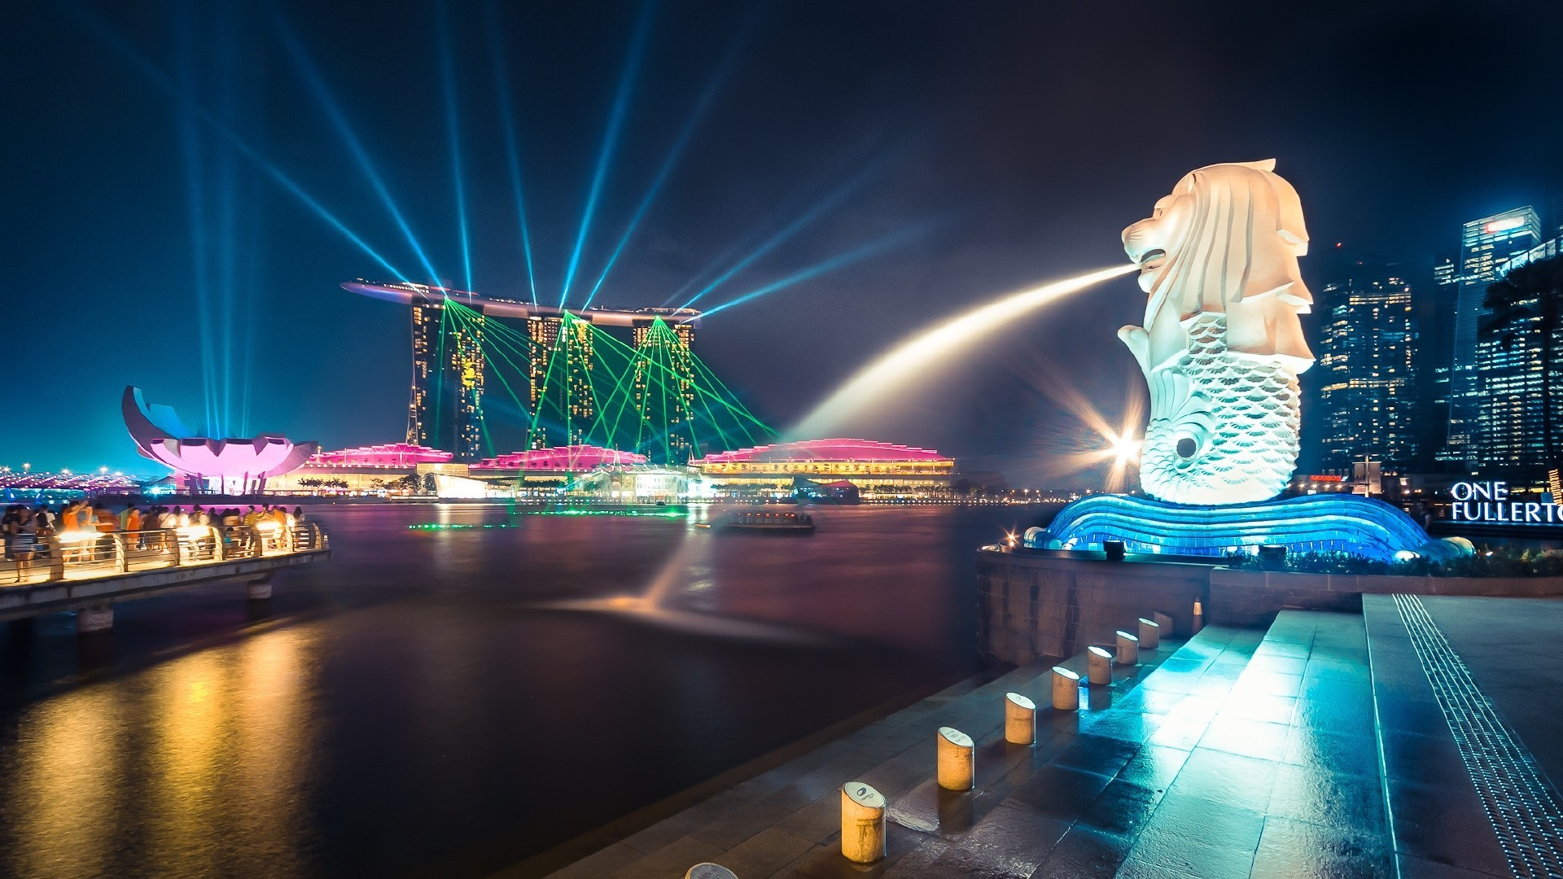
Personal Goal
Vs
Business Goal

Slide 9
Personal Goal
Business Goal
Want & Why? Quit my job so can spend more time with family
How much will USD8000 / month
Takes? (Supervising Coordinator)
When? Dec 31, 2019

Slide 10
Business Goal
Business Goal
When you achieve your business Goal, you will resolve your personal goal

Slide 11
Business Goal
Detailed Business Plan

Slide 12
You
Left Right
Week 1
5000BV
$1500 + $600 Bonus
5000BV
Week 2
5000BV
$1500 + $600 Bonus
5000BV
Week 3
5000BV
$1500 + $600 Bonus
5000BV
5000BV
$1500 + $600 Bonus
5000BV
Week 4
20,000BV
USD 8,400
20,000BV
Target: Finished 5000BV per eg per week .Max out your BDC 001 (Freedom Center)

Slide 13
2 options
Personal Use (Auto ship) = 100BV
Base 10: SABP & Master UFOs 1500BV/ qtr
10 customer buying 40BV per mth = 400BV
Personally use (Auto ship) 100BV
Total = 500 BV per distributor

Slide 14
1) 100 BV Personal Use
You
Left Right
20,000BV/mth
20,000BV/mth
20,000/100BV
=200 UFOs
20,000/100Bv
=200 UFOs

Slide 15
2) Base 10 = 400BV
You
Left Right
20,000BV/mth
20,000BV/mth
20,000/500Bv
=40 UFOs
20,000/500Bv
=40 UFOs

Slide 16
Which is easier?
200 UnFranchise® Owners
Vs
40 UnFranchise® Owners

Slide 17
Our WHY is the reason WHY we established our UnFranchise® but lets not let our WHY also be the reason WHY we Fail
Notes:
17
17

Slide 18
Decide What You are Willing to Give Up or Overcome to Obtain Goals
Emotional Obstacles - timidity, fear of what other people think, fear of public speaking.
Scheduling Obstacles - recreational, civic & church responsibilities, family, employment.
Financial Obstacles - training costs, management tools, support materials.
Notes:
18
18

Slide 19
Emotional Obstacles
Timidity, fear of what other people think, fear of public speaking.
Home event : HBP, Wellness, Shop.com Overview, Beauty, TLS etc
One thing Positive at Coring
Sharing at MAM
Sharing of testimonial

Slide 20
Financial Obstacles
Training costs, management tools, support materials.
Set a Business account and put back all earning until it has accumulate:
USA - USD2000
Singapore – SGD 3000
Malaysia – RM 80000
Anything excess of can be use for personal expense

Slide 21
Time Obstacle
It is all about Priority
ma
ma
ma
ma
ma
Water: Sleep, food, etc
Sand: Job, family, social
ma
Stone

Slide 22
It is all about Priority
ma
Stone
Sand: Job, family, social
ma
ma
ma
Water: Sleep, food, etc
ma
ma

Slide 23
Let’s not Try to
Prioritize our schedule,
But Schedule our Priority
Notes:
23
23

Slide 24
Weekly Goal
Goal Staircase to USD2100 /week
Talked to 5-15 People
Booked 5 Appointments
Added 10 Possibilities
Daily Steps
5
4
3
EVERY DAY STEPS
2
Social Media
Read Goal Statement
Listen to Audio
Talk/call to 1-3 People
Book 1 Appointment
Add 2 Possibilities
1

Slide 25
Monthly Goal
Attend UBP with guest
Show 4 plan
Move 500 BV
Goal Staircase to USD2100 /week
Weekly Steps
WEEKLY
GOAL
5
4
WEEKLY
GOAL
3
2
1
Week 4
5
4
WEEKLY
GOAL
3
2
EACH WEEK
Show Plan 1 times
Follow-Up with 1 Prospect
Add 1 New Customer
Call Your Coach
1
Week 3
5
4
3
2
Week 2
1
5
4
3
2
Week 1
1

Slide 26
Quaterly GOAL
Goal Staircase to USD2100 /week
Master UFO
SAMM
Monthly Steps
12
11
10
9
8
7
Each Month
Attend UBP with guest
Show 4 plan
Move 500 BV
6
5
4
3
2
1

Slide 27
Bi-ANNUAL GOAL
Goal Staircase to USD2100/week
Positioned to earn
$2,100/week ongoing income
QUATERLY Steps
12
11
10
9
8
7
Each 6months
Attend Annual Convention or Leadership Convention
6
5
4
3
2
1

Slide 28
Build from Event to Event
1) Momentum building.
2) Growth gauge.
3) Build Belief level.
4) It all begin with a ticket.
5) ABC pattern in action

Slide 29
Ticket Goal
Why Ticket???
Invest In Knowledge.
Belief in Company.
Belief in Yourself – You can Do It.
Growth Gauge
Leverage

Slide 30
Grow with Ticket
160
240
140
120
120
100
$2,1000/week
80
70
60
Attendance
45
40
20
20
7
10
0
1
3
1st
Reg
Int
2nd
Reg
Int
3rd
Reg
Int
Yr
Yr
Yr
Lead
Lead
Lead

Slide 31
Actual Growth without Ticket
20
10
Attendance
6
5
4
4
3
3
2
1
1
0
1st
Reg
Int
2nd
Reg
Int
3rd
Reg
Int
Yr
Yr
Yr
Lead
Lead
Lead

Slide 32
Measure, Monitor, Adjust and Control
Based on the results from your actions:
Adjust date of completion
Adjust action plan
Attend additional training
Take the Basic 5 Diagnostic quarterly to evaluate progress

Slide 33
90 Days Be In The SYSTEM
Master UFO (quarterly)
Duplication, Growth and multiplier
SAMM
Convert Buying Habit from your own Store.
Product of Product
Momentum
6x6 Momentum
Team Culture
Coring
HBP/UBP
Product Call
Lets Get Started Right

Slide 34
To Achieve your goals you must Believe in yourself and take action

